Slide 1
Advanced Topics Overview
Avanade ASG Data Science Bootcamp

Slide 2
Agenda
1
2
3
4
5
6
Computer Vision
7
Model Explainability
Sebastian
Sahana
Natural Language Processing
Nesli
Graph Neural Networks
Sebastian
Recommender Systems
Kavita
Generative Adversarial Networks
Laura
Deep Reinforcement Learning
Xiang
Notes:
Blue: need Azure

Slide 3
Computer Vision (CV)
Definition, Overview, Example Applications, Convolutional Neural Networks, Resources

Slide 4
Computer Vision Overview (1)
Computer Vision is defined as the field of study that seeks to develop techniques to help computers “see” and understand the content of digital images (incl. videos). At an abstract level, the goal of computer vision problems is to use the observed image data to infer something about the world. (https://machinelearningmastery.com/what-is-computer-vision/).
Typically, developed methods attempt to reproduce the capability of human vision. As such it can be called a subfield of artificial intelligence.
Notes:
- Computer Vision is not Image Processing (digital signal processing that is not concerned with understanding the content) but Image Processing regularly is part of Computer Vision.
- Anecdote: Making a computer see was something that leading experts in the field of Artificial Intelligence thought to be at the level of difficulty of a summer student’s project back in the sixties. Forty years later the task is still unsolved and seems formidable.

Slide 5
Computer Vision Overview (2)
Vision is trivially solved by even very young children, but it is surprisingly challenging for computers to deal with the complexity of a dynamic and nearly infinitely varying physical world.
One of the reasons is that we don’t have a strong grasp of how biological vision works (like with pretty much everything that involves the brain).
Another reason is that humans collect context over their lifetimes which informs human vision but is not yet adequately reflected in computer vision systems.
While there are still many challenges to be solved in Computer Vision, deep learning has taken over the field, rendering traditional statistical and ML approaches practically irrelevant.
With deep learning, constrained problems can be easily solved.
Notes:
- Computer Vision is not Image Processing (digital signal processing that is not concerned with understanding the content) but Image Processing regularly is part of Computer Vision.
- Anecdote: Making a computer see was something that leading experts in the field of Artificial Intelligence thought to be at the level of difficulty of a summer student’s project back in the sixties. Forty years later the task is still unsolved and seems formidable.

Slide 6
How is Computer Vision Useful?
Abundance of digital image and video data (Internet, IoT) through technological advances led to many value-generating use cases:
Indexing and searching images and videos
Optical character recognition (OCR)
Robot navigation
Industrial inspection and maintenance
Automated retail checkouts
Medical imaging
Autonomous driving and automotive safety
Surveillance and military intelligence
Human computer interaction
Biometrics
Realistic rendering of computer graphics
…

Slide 7
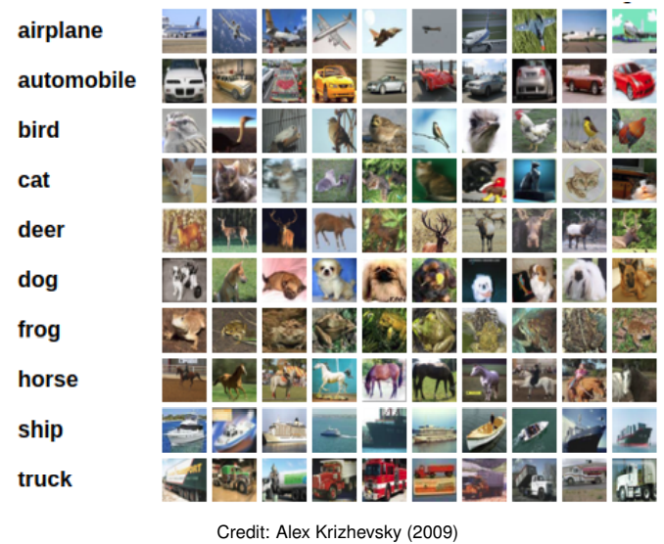
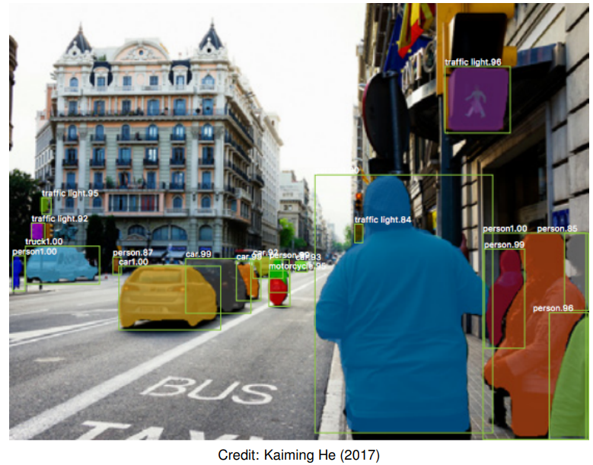
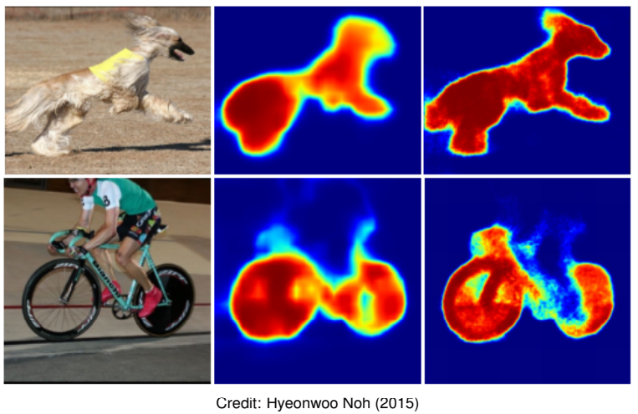
Computer Vision Tasks
Image Classification: What broad category of object is in this photograph?
Object Identification: Which type of a given object is in this photograph?
Object Verification: Is the object in the photograph?
Object Detection: Where are the objects in the photograph?
Object Landmark Detection: What are the key points for the object in the photograph?
Object Segmentation: What pixels belong to the object in the image?
Object Recognition: What objects are in this photograph and where are they?
Image classification: predict a single label for each image
Object detection: generate bounding boxes for each instance
Instance segmentation: partition the image into segments

Slide 8
Computer Vision Algorithms & Methods
Nowadays, there are 2 main algorithms dominating the computer vision field, both deep-learning based:
Convolutional Neural Networks
Vision Transformers
Transfer learning and self-supervised learning (particularly contrastive learning) are key methods to reach success in computer vision tasks.
Transfer learning: Transfer learning is a machine learning technique where a model trained on one task is re-purposed on a second related task.
Self-supervised learning: A form of unsupervised learning where the data provides the supervision
Contrastive learning: Contrastive learning is a machine learning technique used to learn the general features of a dataset without labels by teaching the model which data points are similar or different (very good article: https://towardsdatascience.com/understanding-contrastive-learning-d5b19fd96607).
ImageNet is the biggest labeled image database with approx. 15 million images of 21,000 classes (labeled through 49,000 Amazon Mechanical Turk workers) -> https://www.image-net.org/
This resource is very often used for pre-training computer vision models with transfer learning.

Slide 9
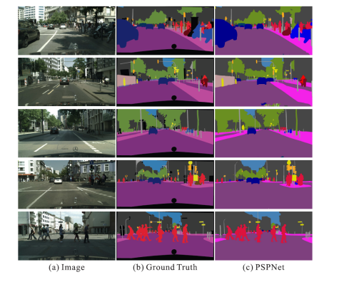
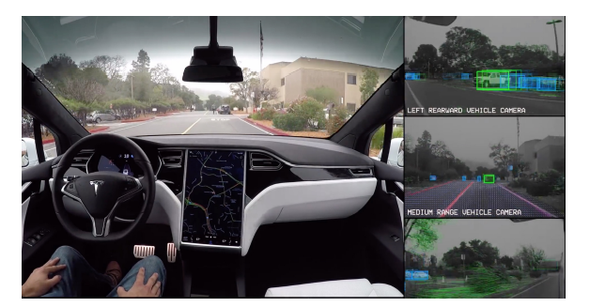
Computer Vision Example Applications
Figure: All Tesla cars being produced now have full self-driving hardware (Source: Tesla website). A convolutional neural network is used to map raw pixels from a single front-facing camera directly into steering commands. The system learns to drive in traffic, on local roads, with or without lane markings as well as on highways.
Figure: Given an input image, a CNN is first used to get the feature map of the last convolutional layer, then a pyramid parsing module is applied to harvest different sub-region representations, followed by upsampling and concatenation layers to form the final feature representation, which carries both local and global context information. Finally, the representation is fed into a convolution layer to get the final per-pixel prediction. (Source: pyramid scene parsing network, by Zhao et. al, CVPR 2017)

Slide 10
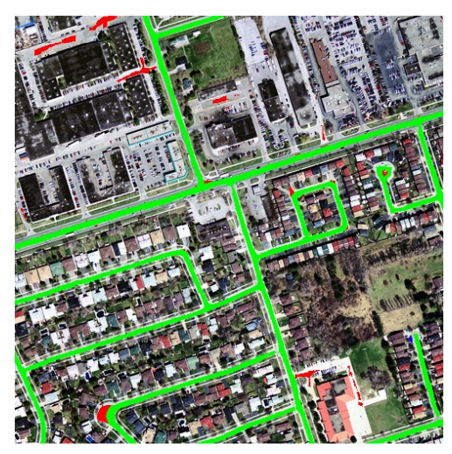
Computer Vision Example Applications
Figure: Road segmentation (Mnih Volodymyr (2013)). Aerial images and possibly outdated map pixels are segmented.

Slide 11
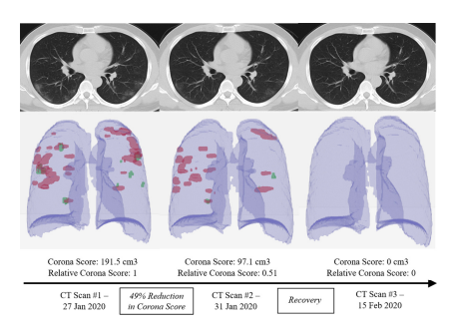
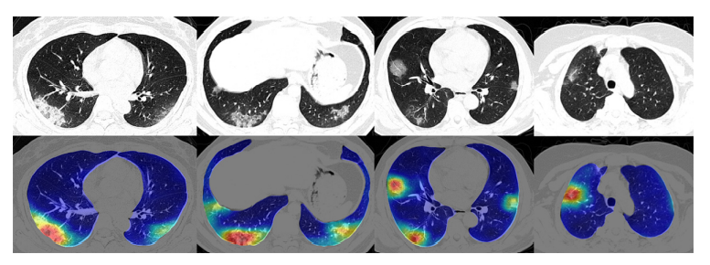
Computer Vision Example Applications
Figure: Four COVID-19 lung CT scans at the top with corresponding colored maps showing Corona virus abnormalities at the bottom (Source: Megan Scudellari, IEEE Spectrum 2021).
Figure: CNN based method (RADLogists) for personalized Covid-19 detection: three CT scans from a single Corona virus patient diagnosed by RADLogists

Slide 12
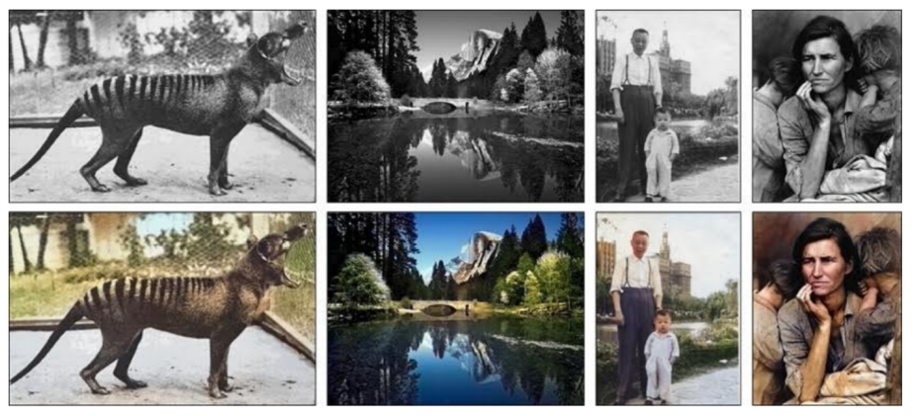
Computer Vision Example Applications
Figure: Image Colorization is another interesting application of CNN in computer vision (Zhang et al. (2016)). Given a grayscale photo as the input (top row), this network solves the problem of hallucinating a plausible color version of the photo (bottom row, i.e. the prediction of the network).

Slide 13
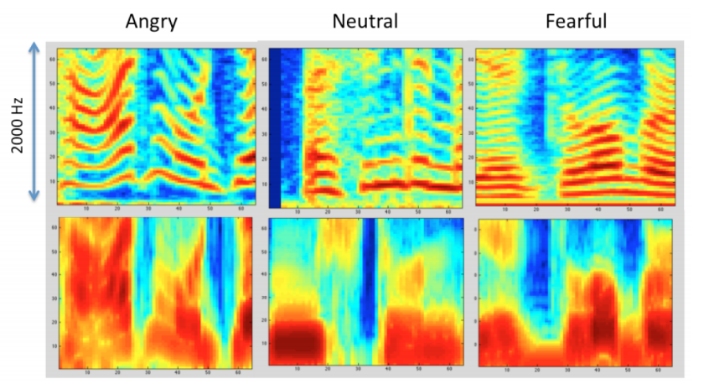
Computer Vision Example Applications
Figure: Speech recognition (Anand & Verma (2015)). Convolutional neural network is used to learn features from the audio data in order to classify emotions.

Slide 14
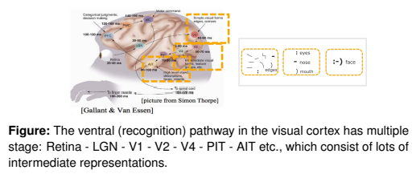
Recap: Convolutional Neural Networks
Convolutional Neural Networks (CNNs, or ConvNets) are a powerful family of neural network architectures in which the connectivity pattern between neurons resembles the organization of the mammal visual cortex.
Basic idea: a CNN automatically extracts visual, or, more generally, spatial features from the input data such that it is able to make the optimal prediction based on the extracted features.

Slide 15
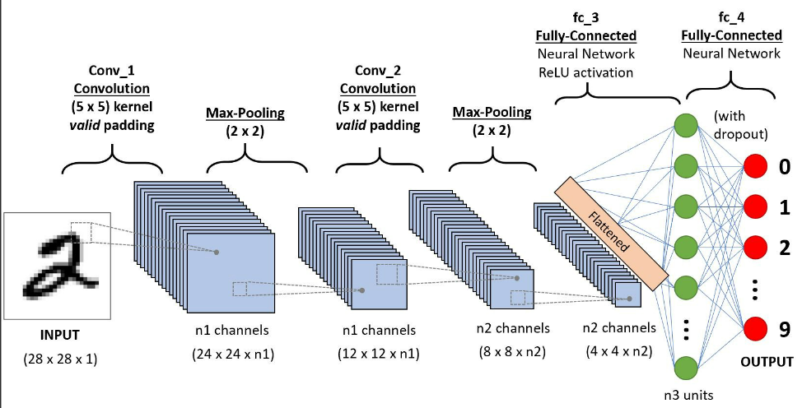
Recap: Convolutional Neural Networks
Input layer takes input data (e.g. image).
Convolution layers extract feature maps from the previous layers.
Pooling layers reduce the dimensionality of feature maps and filter meaningful features.

Slide 16
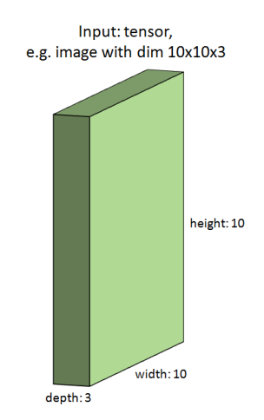
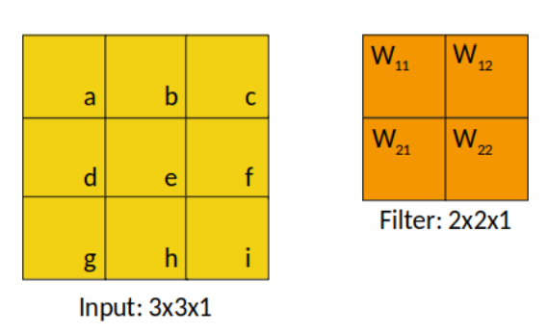
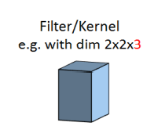
Convolutional Neural Networks
An image is represented by an input tensor, for example with dimensions 10 × 10 × 3 (3 color channels).
We have a learnable filter of size 2.
Or alternatively a 2D visualization of a very tiny greyscale image
Notes:
- Nice to work together in a bigger team of data science enthusiasts

Slide 17
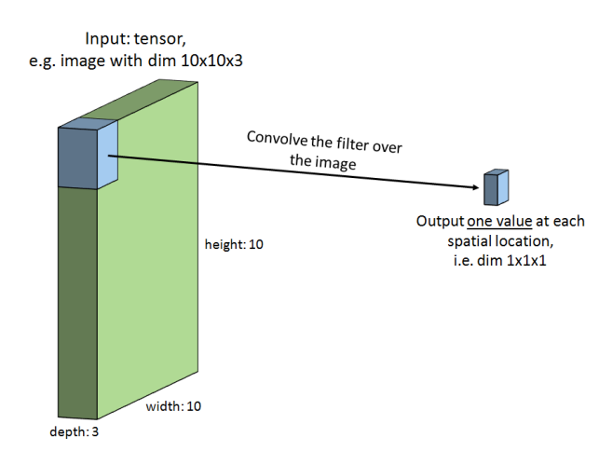
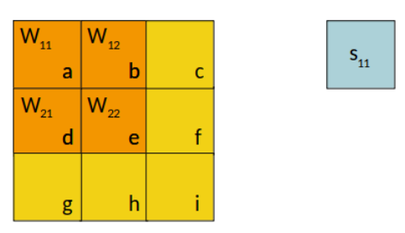
Convolutional Neural Networks
We convolve the filter over the first spatial location, yielding a scalar value.
This is just matrix multiplication again…
Notes:
- Nice to work together in a bigger team of data science enthusiasts

Slide 18
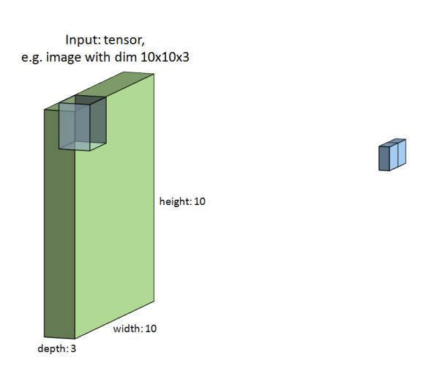
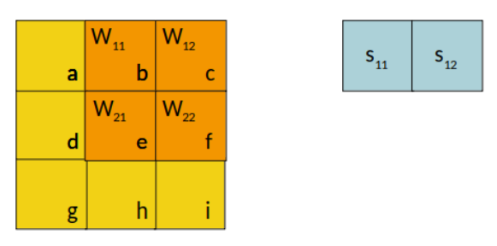
Convolutional Neural Networks
The we shift the filter to the next spatial location.
Notes:
- Nice to work together in a bigger team of data science enthusiasts

Slide 19
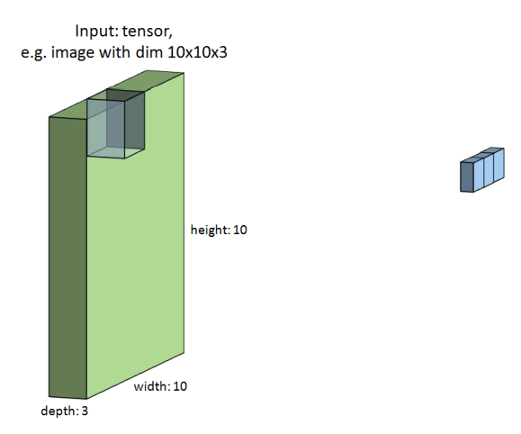
Convolutional Neural Networks
And the next…
Notes:
- Nice to work together in a bigger team of data science enthusiasts

Slide 20
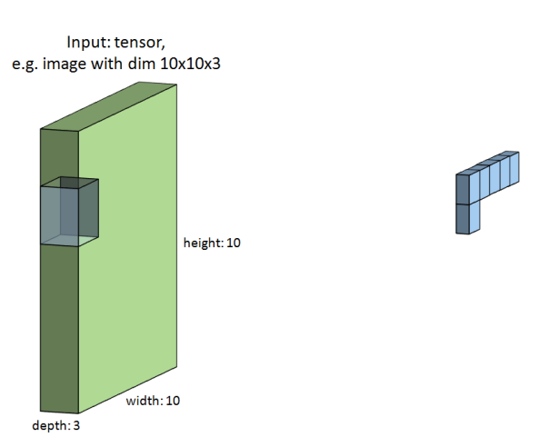
Convolutional Neural Networks
And so on…
Notes:
- Nice to work together in a bigger team of data science enthusiasts

Slide 21
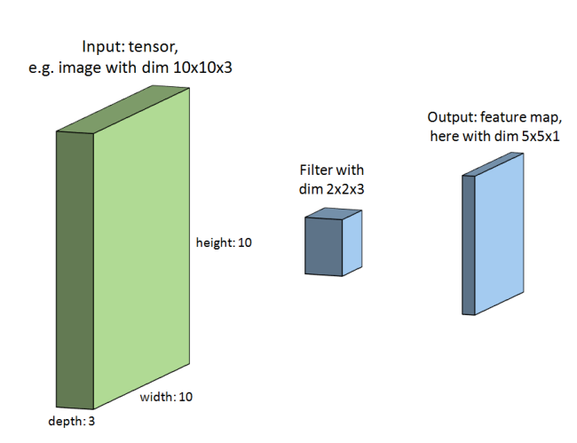
Convolutional Neural Networks
Finally, we obtain an output feature map.
Notes:
- Nice to work together in a bigger team of data science enthusiasts

Slide 22
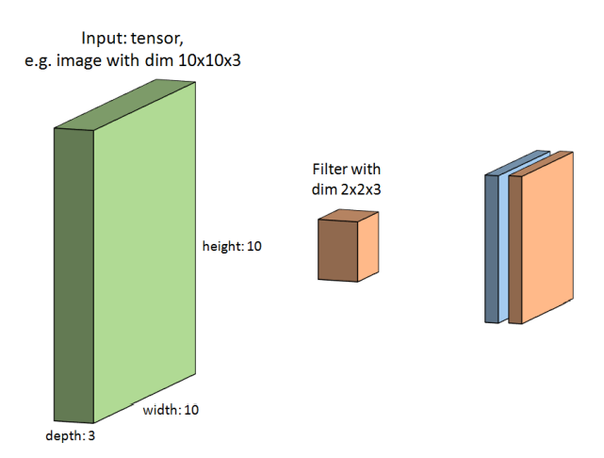
Convolutional Neural Networks
We do the same with a second filter to get a second output feature map. This filter learns something different from the image.
Notes:
- Nice to work together in a bigger team of data science enthusiasts

Slide 23
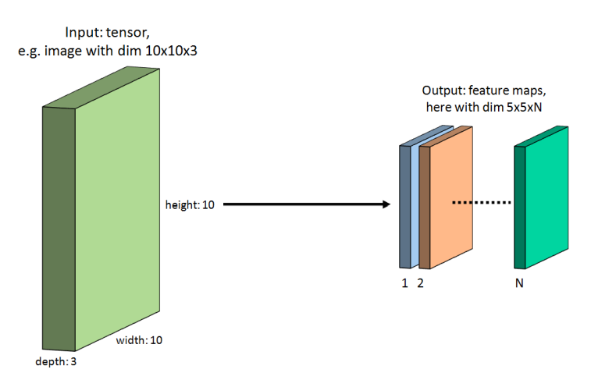
Convolutional Neural Networks
All feature maps together yield us a “new image” with dim h x w x N. We actually append them to a new tensor with depth = # filters.
Notes:
- Nice to work together in a bigger team of data science enthusiasts

Slide 24
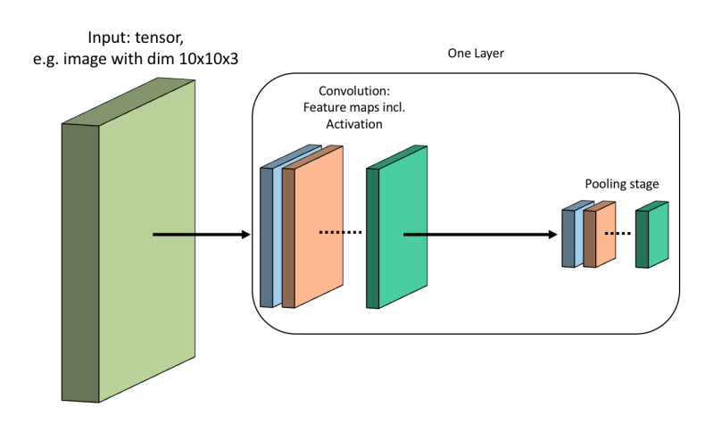
Convolutional Neural Networks
All feature map entries will then be activated via an activation function (e.g. ReLU), just like in a fully connected neural network.
One may use pooling operations to downsample the dimensions of the feature maps. Pooling is applied on each feature map independently.
Notes:
- Nice to work together in a bigger team of data science enthusiasts

Slide 25
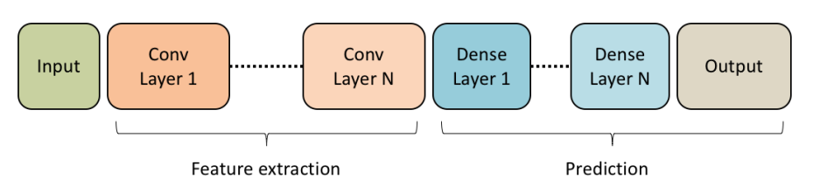
Convolutional Neural Networks
Many of these layers can be placed successively, to extract even more complex features. The second Conv Layer gets the feature maps from the first Conv Layer as input.
The feature maps of the final Conv Layer are flattened (into a vector) and fed into a fully connected layer which, in turn, is followed by more fully connected layers to finally obtain the output.
Notes:
- Nice to work together in a bigger team of data science enthusiasts

Slide 26
Computer Vision Resources
Deep Learning for Computer Vision Standford Course
Convolutional Neural Networks Coursera Course
An Introduction to Convolutional Neural Networks Paper
Notes:
- Nice to work together in a bigger team of data science enthusiasts

Slide 27
Natural Language Processing (NLP)
NLP Overview, Application, Use Cases, State-of-Arts Techniques

Slide 28
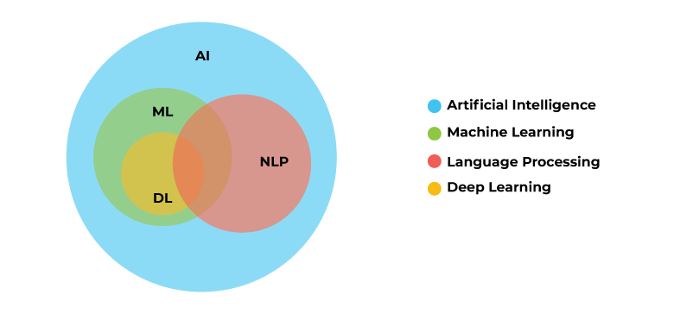
NLP Overview
AI is an umbrella term for machines that can simulate human intelligence, while NLP and ML are both subfields of AI.
While we are using NLP to redefine how machines understand human languages and behavior, Deep learning is enriching NLP applications. Deep learning and vector-mapping make natural language processing more accurate without the need for much human intervention.
Natural Language Processing is a form of AI that gives machines the ability to read, to understand and interpret human language.
With NLP, machines can make sense of written or spoken text and perform tasks including speech recognition, sentiment analysis, and automatic text summarization.

Slide 29
NLP Applications
Some NLP-based solutions include translation, speech recognition, sentiment analysis, question/answer systems, chatbots, automatic text summarization, market intelligence, automatic text classification, and automatic grammar checking. These technologies help organizations to analyze data, discover insights, automate time-consuming processes and/or gain competitive advantages.
Sentiment Analysis; able to recognize nuances in emotions and opinions ‒ and determine how positive or negative they are.
Evaluate public opinion
Monitor brand reputation
Understand the customer experience
Online Sentiment Analysis
Text Classification; a text analysis task that also includes sentiment analysis, involves automatically understanding, processing, and categorizing unstructured text.
Spam Detection

Slide 30

NLP Applications
Chatbots are programs used to provide automated answers to common customer queries.
Customer support services
In healthcare, they can collect intake data, help patients assess their symptoms, and determine next steps.
Text Extraction (NER); automatically detects specific information in a text, such as names, companies, places, and more.
Customer Support; sifting through incoming support tickets and identifying specific data, like company names, order numbers, and email addresses without needing to open and read every ticket.
HR; Speed up the hiring process by summarizing applicants’ CVs
Search Engines
Keyword Extractor

Slide 31
NLP Applications
Machine Translation, involves more than replacing words in one language with words from another. Effective translation has to capture accurately the meaning and tone of the input language and translate it to text with the same meaning and desired impact in the output language. Machine translation tools are making good progress in terms of accuracy.
Google Translate
Speech recognition is a machine’s ability to identify and interpret phrases and words from spoken language and convert them into a machine-readable format. It uses NLP to allow computers to simulate human interaction, and ML to respond in a way that mimics human responses.
Apple’s Siri, Amazon’s Alexa
Text Summarization
Topic Modelling

Slide 32
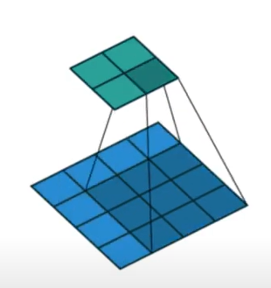
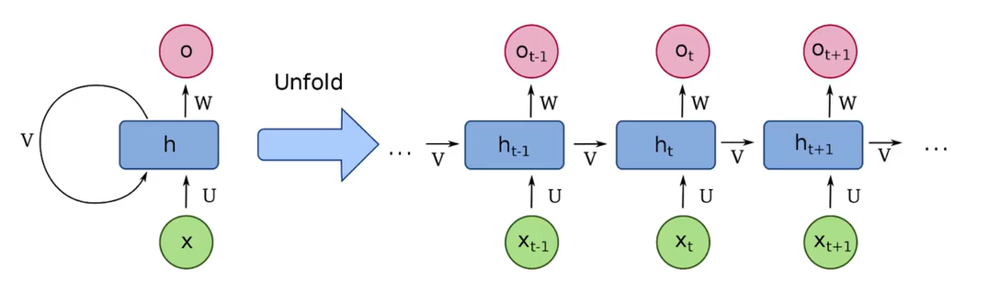
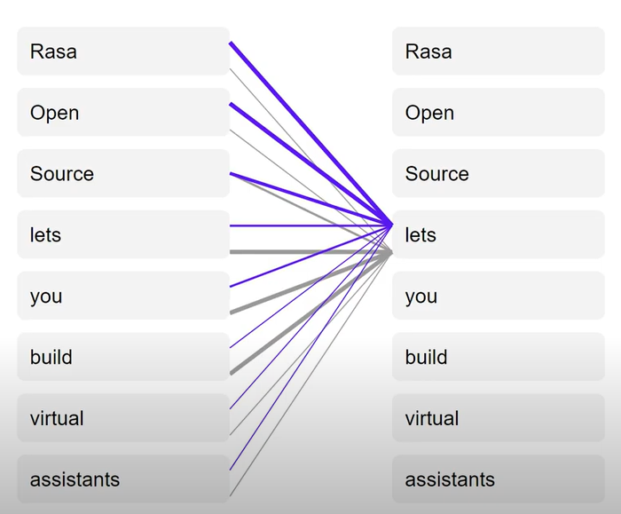
State-of-art DL Techniques in NLP
CNN
Convolutional Neural Networks
General Idea: You have a sliding window that reduces things down to fewer dimensions
RNN
Recurrent Neural Networks
General Idea: You have a sliding window that moves along an input sequence
Transformer
Attention of all you need
Attention: You learn to weight the relationship of each item in the input sequence to items in the output sequence
Hasn’t been successful for language dataset.
Good success with many NL data
Need to move in order of sequence
Limited to parallelize training
Sentences are processed as a whole rather than word by word, ‘unit’ used to compute similarity scores between words in a sentence
Good for image dataset
Best for sequential data
The farther apart relevant points in the sequence are, the harder it is to make connections between them
There is no limit on parallelized training
Self attention: You learn to weight the relationship of each item in the input sequence to all other items in the input sequence
Multi-headed self attention: You learn multiple ways to weight the relationship of each item in the input sequence to all other items in the input
Very large models that require a lot of memory and compute to train
Encoder and decoder is made up number of multi-headed self attentions
Some transformers; BERT, XLNet, RoBERTa

Slide 33
Resources
Monkey Learn
IBM
Towards Data Science
Notes:
- Nice to work together in a bigger team of data science enthusiasts

Slide 34
Graph Neural Networks (GNNs)
Definition, Overview, Example Applications, Resources

Slide 35
Acknowledgement
Many of the following slides are inspired by and include screenshots taken from Jure Leskovec’ class Stanford CS224W: Machine Learning with Graphs.

Slide 36
Graphs Introduction
Graphs are a general language for describing and analyzing entities with relations / interactions.
Isolated Data Points
Graph

Slide 37
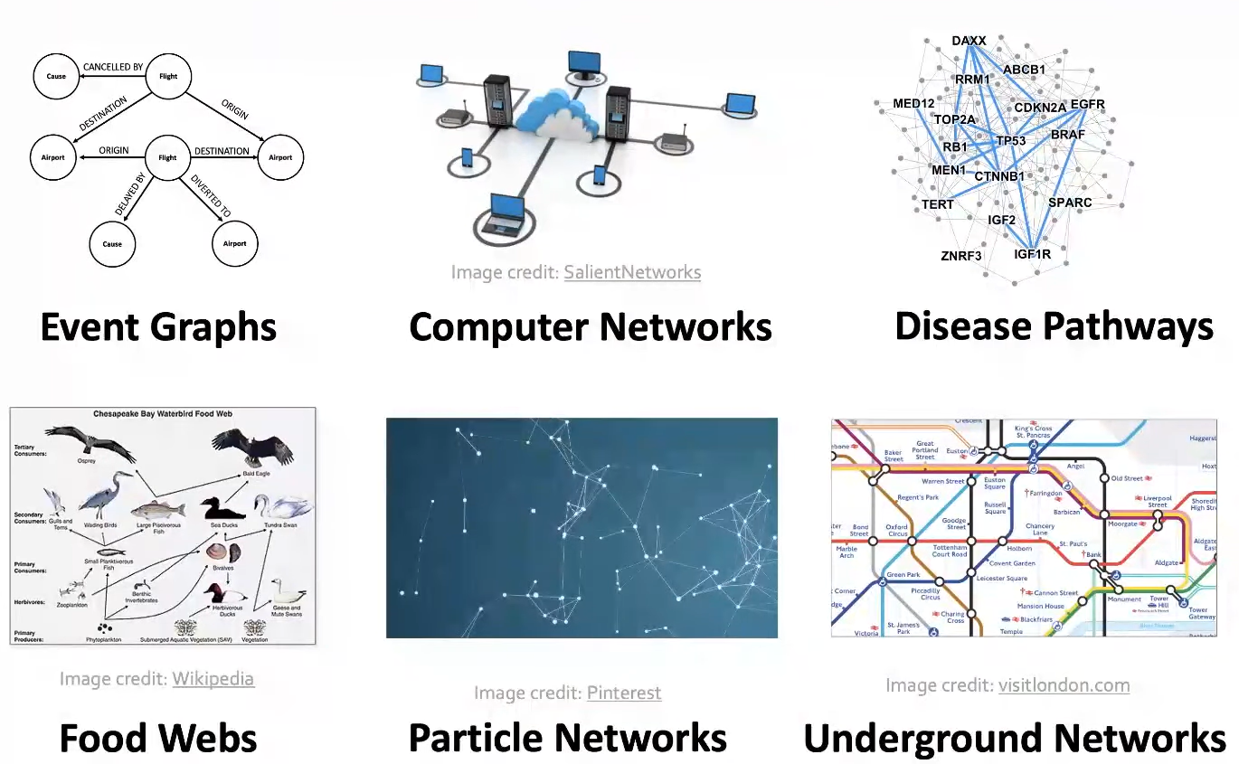
Many Types of Data are Graphs (1)
Notes:
- Modelling / representing this kind of data as a graph with relations between data points, allows us to build much better models of the underlying data.

Slide 38
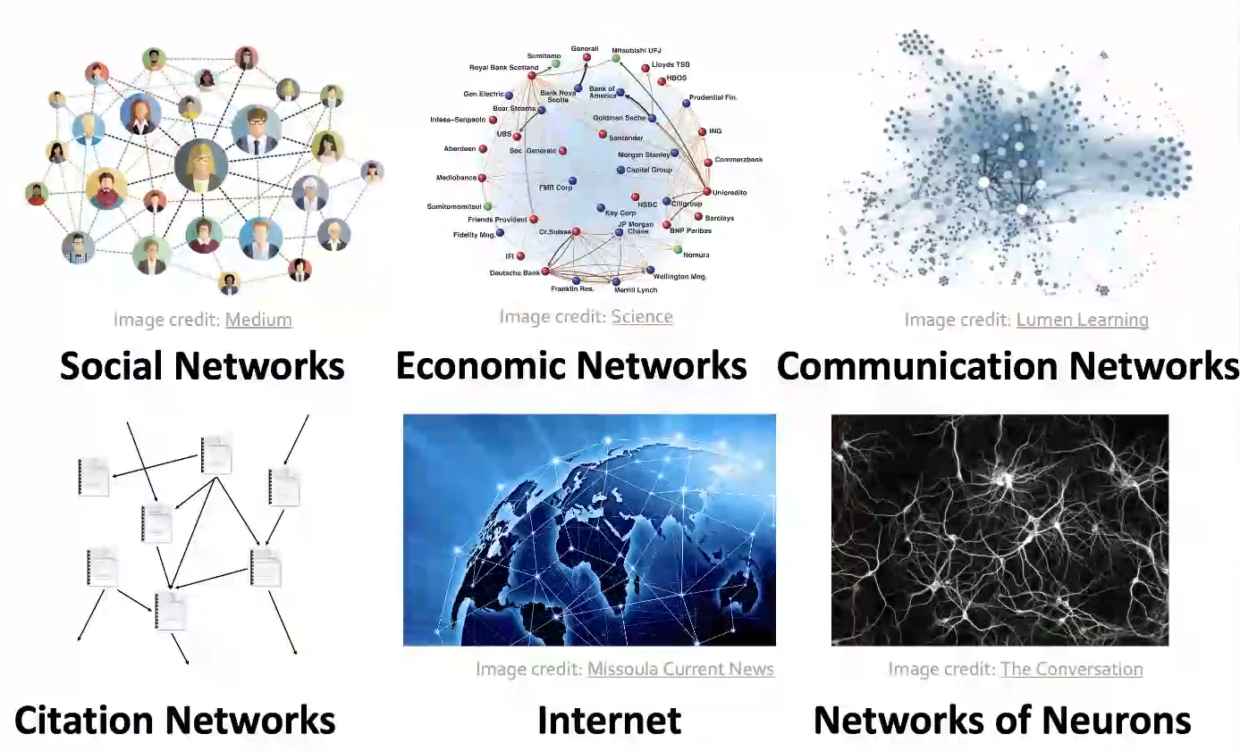
Many Types of Data are Graphs (2)
Notes:
- Modelling / representing this kind of data as a graph with relations between data points, allows us to build much better models of the underlying data.

Slide 39
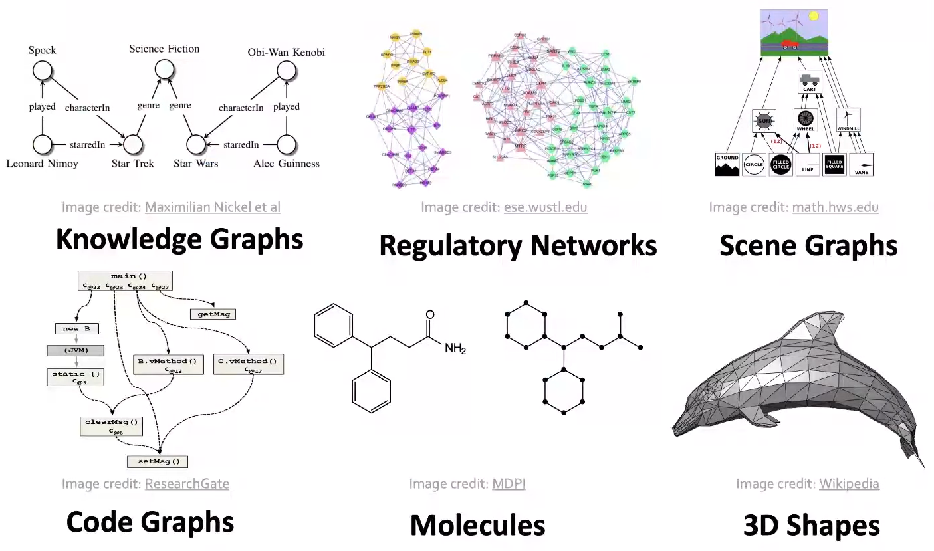
Many Types of Data are Graphs (3)
Other data can also be represented as graphs
User-item relationships in recommender systems
Notes:
- Modelling / representing this kind of data as a graph with relations between data points, allows us to build much better models of the underlying data.

Slide 40
Two Types of Graphs
Networks (Natural Graphs)
The underlying domain can naturally be represented as a graph.
Examples: social networks, communication networks, biomedical interaction networks, neuronal networks
Graphs as a Representation
We can use graphs to represent relationships between data points.
Examples: knowledge graphs, software graphs, similarity networks (connect similar data points), item-user relationships, relational structures (molecules, scene graphs, 3D shapes)
Sometimes the distinction between the two types is blurred.
Notes:
- Modelling / representing this kind of data as a graph with relations between data points, allows us to build much better models of the underlying data.

Slide 41
Graph Neural Networks (GNNs) Introduction (1)
Goal: take advantage of relational structure for better predictions. By explicitly modeling relationships we achieve better performance in complex domains!
So far, we have seen deep learning for tabular data (fully connected neural networks), sequence data (recurrent neural networks, transformers), grid data (convolutional neural networks). Graph Neural Networks operate on graph-structured data.
Sequence Data (e.g. Text)
Tabular Data
Grid Data (e.g. Images)
Graph Data (e.g. Social Networks)
Notes:
Sequence: linear structure
Grid: spatial locality, item-user relationships

Slide 42
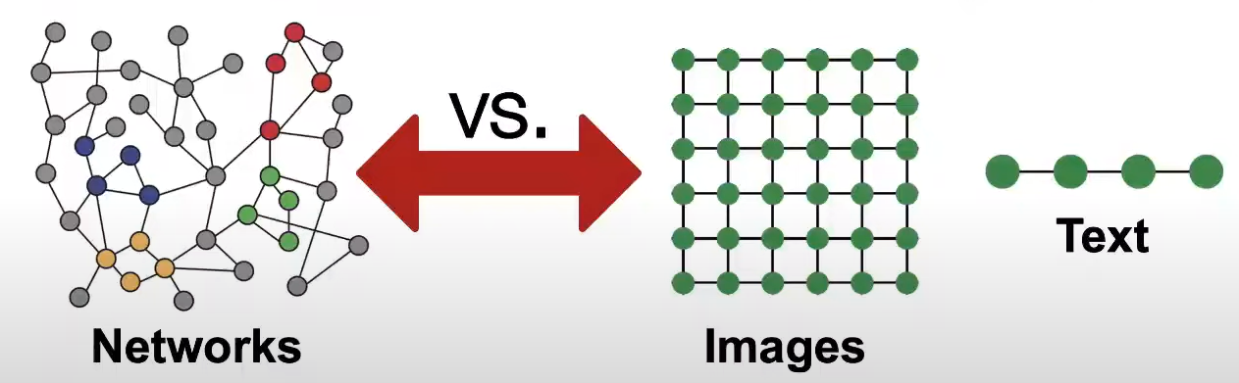
Graph Neural Networks (GNNs) Introduction (2)
One big difference between GNNs and conventional neural networks is that we explicitly model relationships between data examples and don’t have an i.i.d. assumption of examples. The technical term that is used is that we have a relational inductive bias.
There are some challenges with GNNs
Networks are complex!
Arbitrary size and complex topological structure (i.e., no spatial locality like grids)
No fixed node ordering or reference point
Often dynamic with multimodal features
Notes:
- Nice to work together in a bigger team of data science enthusiasts

Slide 43
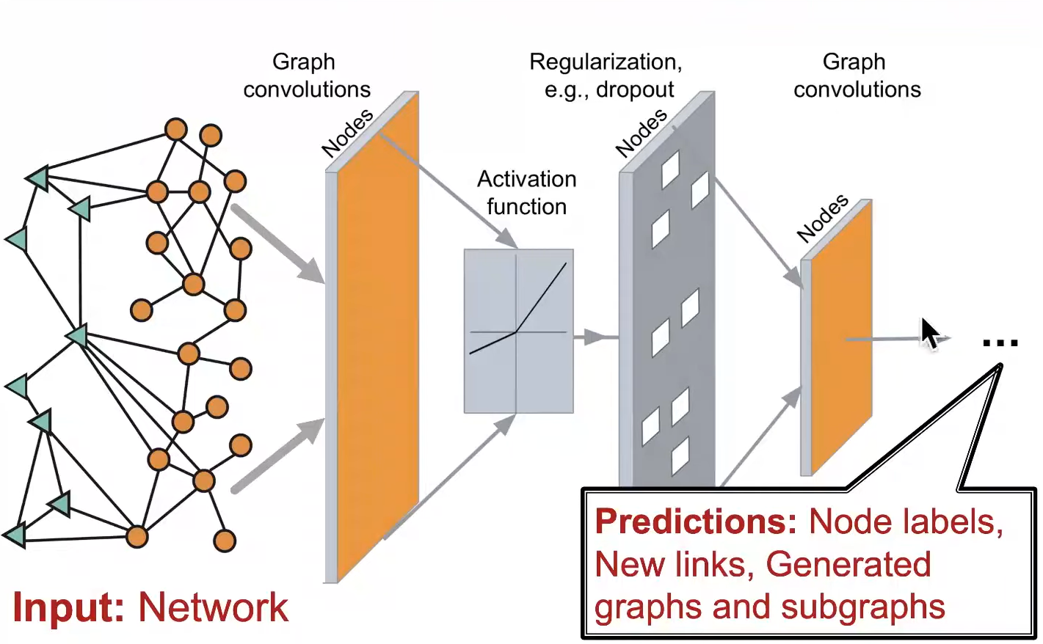
Graph Neural Networks (GNNs) Introduction (3)
Develop neural networks that are broadly applicable and tackle these kind of challenges.
Graphs are one of the new frontiers of deep learning and representation learning research!
The neural network architecture should allow end-to-end modelling with networks as input to different types of prediction as output
Notes:
- Nice to work together in a bigger team of data science enthusiasts

Slide 44
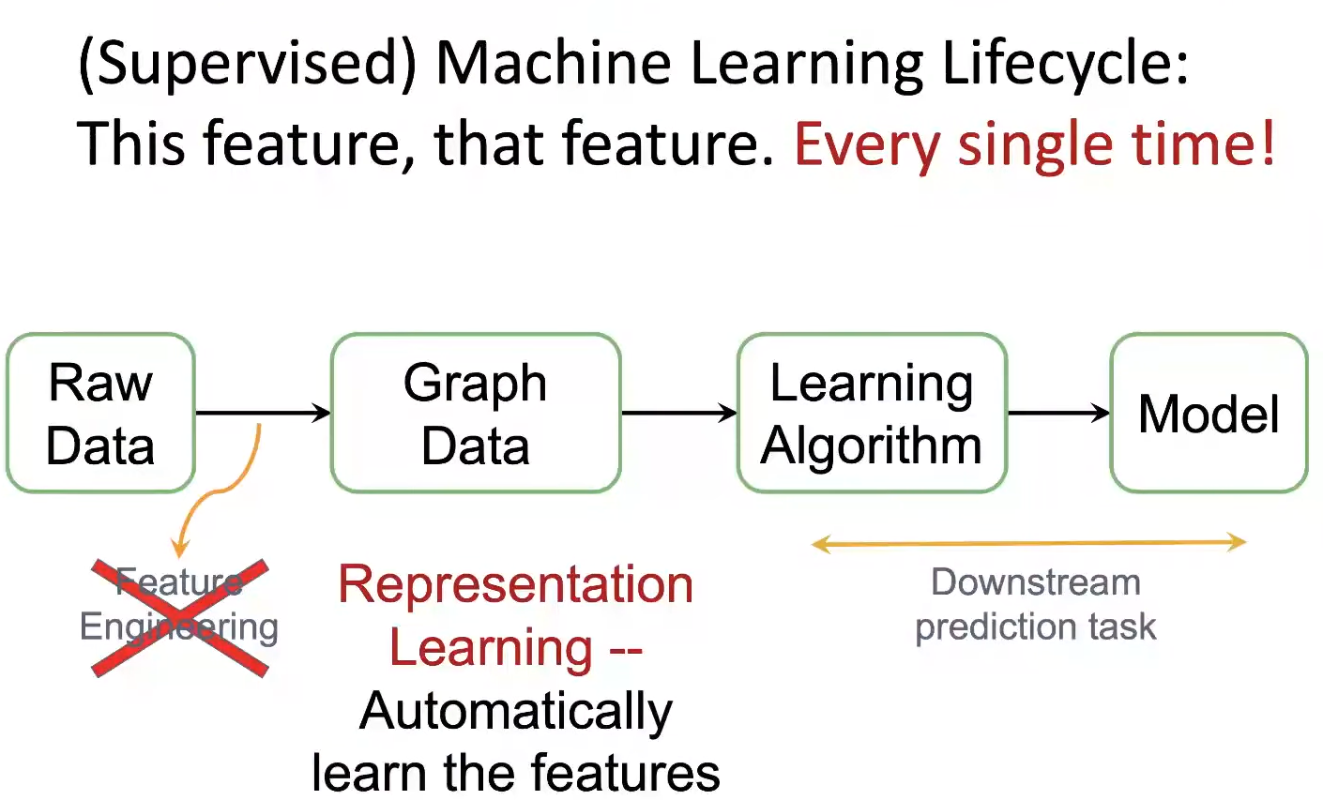
Graph Representation Learning (1)
Notes:
- Nice to work together in a bigger team of data science enthusiasts

Slide 45
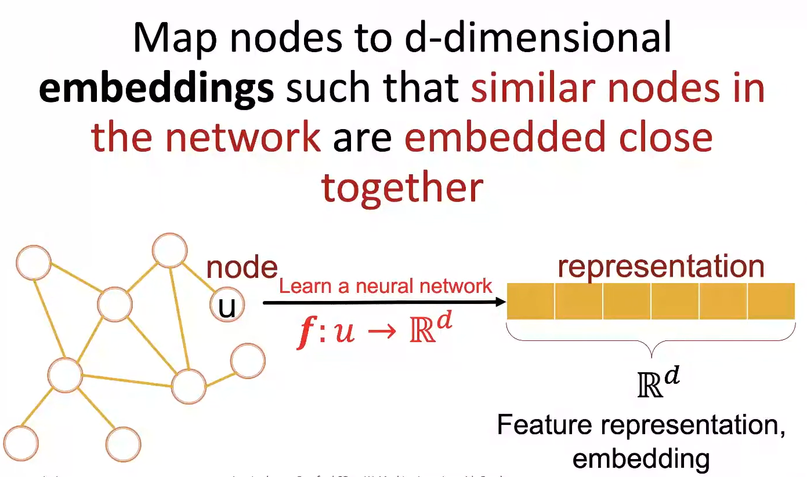
Graph Representation Learning (2)
Notes:
- Nice to work together in a bigger team of data science enthusiasts

Slide 46
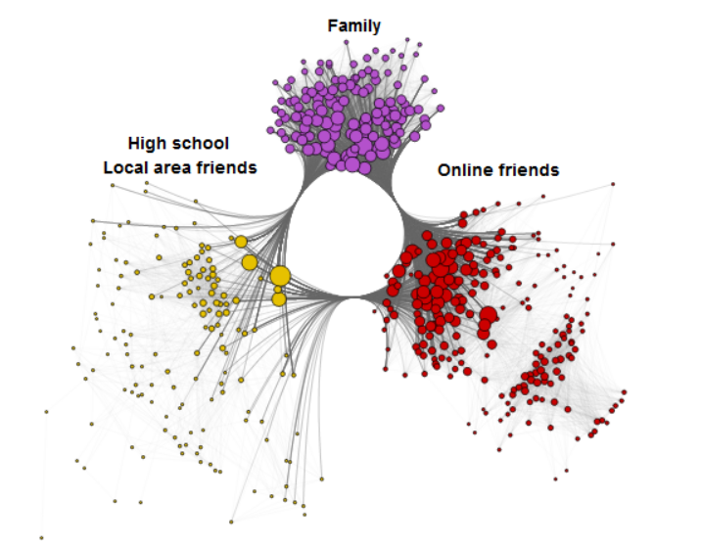
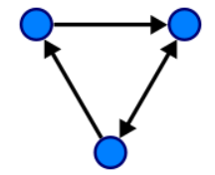
Different Notions of Graphs
A graph G can be defined as G = (V, E), where V is the set of nodes, and E are the edges between them.
There are many variations of graphs
Directed vs undirected
With or without node features
With or without edge features
Multiple edges
Multiple edge types
Self loops
…
Notes:
- Nice to work together in a bigger team of data science enthusiasts

Slide 47
Prediction Tasks with Graphs
Node Prediction
Link / Edge Prediction
Community Prediction
Graph Prediction Graph Generation
Notes:
- Nice to work together in a bigger team of data science enthusiasts

Slide 48
Classic Example Tasks of GNNs
Node classification: Predict a property of a node
Example: categorize online users / items in a recommender system
Link prediction: Predict whether there are missing links between two nodes
Example: knowledge graph completion, social network recommendations
Graph classification: Categorize different graphs
Example: molecule property prediction
Clustering: Detect if nodes form a community
Example: Social circle detection
Other tasks:
Graph generation: drug discovery
Graph evolution: network simulation
Notes:
- Nice to work together in a bigger team of data science enthusiasts

Slide 49
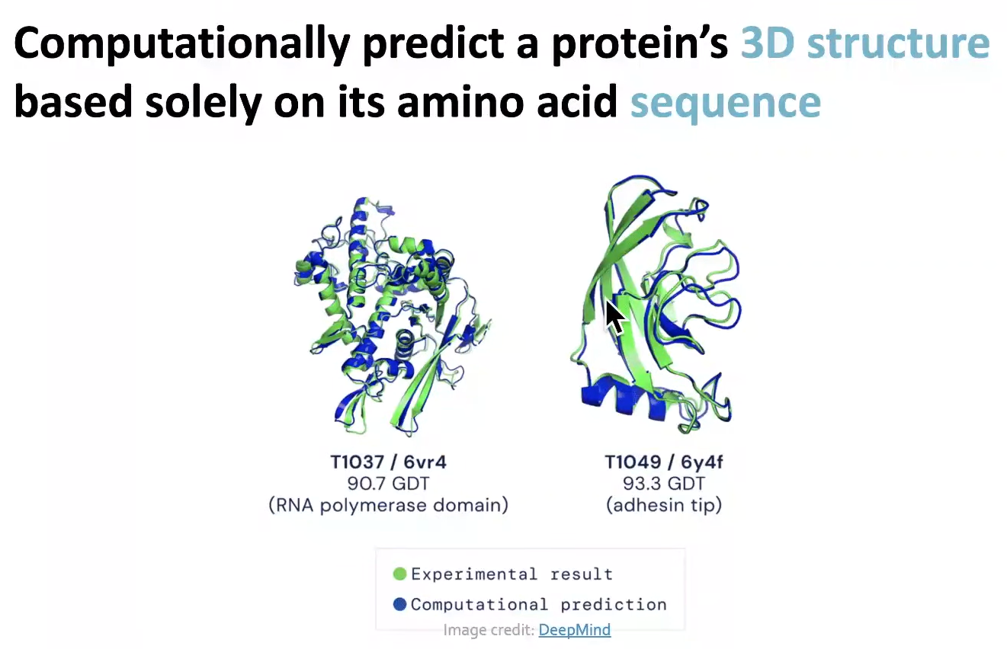
High Impact Example Application: Protein Folding
Key idea: “spatial graph”:
Nodes: amino acids in a protein sequence
Edges: proximity between amino acids
Notes:
- Nice to work together in a bigger team of data science enthusiasts

Slide 50
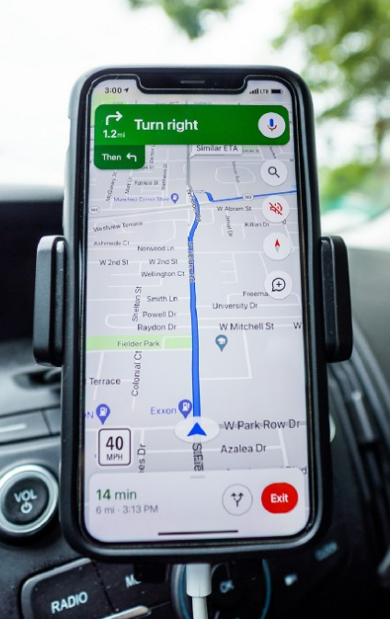
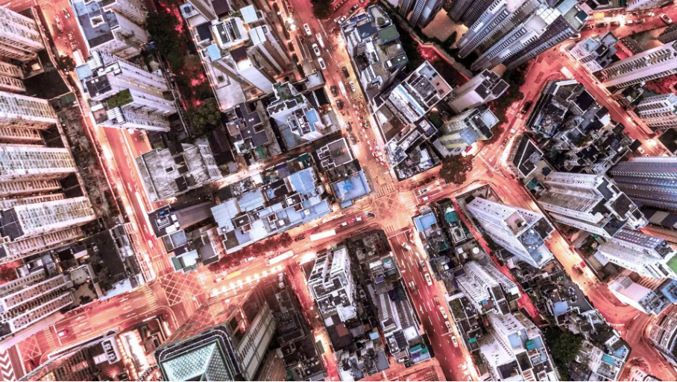
High Impact Example Application: Traffic Prediction
https://www.deepmind.com/blog/traffic-prediction-with-advanced-graph-neural-networks
Notes:
- Nice to work together in a bigger team of data science enthusiasts

Slide 51
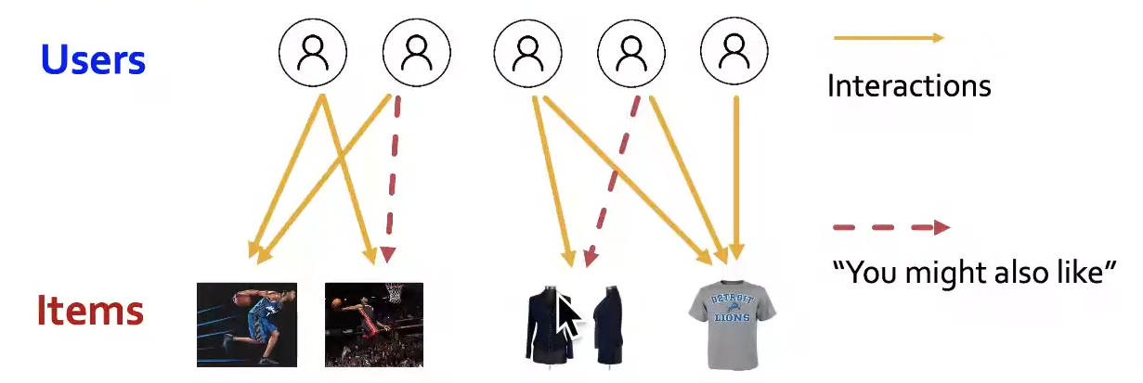
High Impact Example Application: Recommender Systems
Notes:
- Nice to work together in a bigger team of data science enthusiasts

Slide 52
GNNs Resources
A Gentle Introduction to Graph Neural Networks on Distill
Stanford CS224W: Machine Learning with Graphs Lecture
Podcast with Matthias Fey, creator of the PyTorch Geometric library
Notes:
- Nice to work together in a bigger team of data science enthusiasts

Slide 53
Recommender Systems
Content-based filtering, Collaborative Filtering & Hybrid Approach with

Slide 54
Agenda - Recommender Engines
Introduction Approaches for Recommender Engines & Uses
Content-based filtering
Collaborative filtering
Graph-based modelling for hybrid approach with GNNs
Further Notes & Remarks

Slide 55
Recommender Systems
Solves the problem of recommending items to users who are most likely to buy those items
Uses:
Movie and series recommendation from Netflix or music from Spotify
In e-commerce e.g. Amazon
Two approaches: content-based & collaborative filtering
Content-based filtering
Based on individual preference of users with regards to properties and features of items the RS recommends certain items to certain users?
Collaborative filtering
Based on user-item interaction (views, clicks, purchases) items are recommended to users based on what other similar users have bought before
Hybrid filtering
Combination of content-based filtering and collaborative filtering. While many algorithms can only solve one problem, it is Graph Neural Networks (GNNs) which can address both problems simultaneously

Slide 56
Content-based Filtering: Matrix Completion
First, we need to model how we represent the data before we apply any algorithm
Representation as interaction matrix R (clicks, reviews, purchases): #users x #items
Matrix Completion Problem: since not all cells will have data (sparse matrix), we can derive R from the feature matrices U and I
suppose we have f features (e.g. for movie genres: action, comedy etc.). Each user is linked to those features in a user matrix U (u x f) and each item is linked to those features I (i x f)
Given U and I, we compute R: U x I which will give us the complete Interaction matrix R
Problem of content-based-filtering:
simplistic and not very accurate
Only way to improve it, is to add more features
Static approach – no way to learn from changing user data
This is how Netflix started, but making users fill in a long form of their preferences is tedious for them

Slide 57
Content-Filtering: Matrix Completion
 | I 1 | I 2 | I 3 | I 4 | I 5
U 1 | 5 | 4 |  |  | 1
U 2 | 4 |  |  | 4
U 3 |  | 3
U 4 |  |  | 2 |  | 4
U 5 | 5
U 6 |  |  | 5 | 3 | 2
U 7 |  | 3
 | F 1 | F 2 | …
I 1 | 5 | 4 | 5
I 2 | 4 | 5 | 2
I 3 | 3 | 2 | 3
I 4 | 4 | 9 | 1
I 5 | 3 | 1 | 5
I 6 | 2 | 2 | 2
I 7 | 5 | 5 | 5
 | F 1 | F 2 | …
U 1 | 1 | 4 | 3
U 2 | 4 | 3 | 2
U 3 | 3 | 2 | 5
U 4 | 1 | 9 | 3
U 5 | 5 | 5 | 5
U 6 | 2 | 4 | 2
U 7 | 1 | 3 | 3
Rating/Preference or Interaction Matrix R
U 1: User 1, …
I 1: Item 1, …
Feature Matrices:
U 1: User 1, … I 1: Item 1, …
F 1: Feature 1, …
R = U x transp(I)
Where U is u x f, I is i x f and R is a u x i matrix
57

Slide 58
Collaborative Filtering: Matrix Factorization
Reversing the problem of content-based filtering: given Matrix R which contains the information on user-item interaction (reviews, clicks, purchase) we compute the feature vectors U and I
However, the features will not directly interpretable by humans, since they are compressions of the original features (e.g. movie genres). This is only possible if there are learnable patterns in the data which are not random -> problem of representation learning
Issues with Matrix representation
matrix R is usually very sparse
Spatial neighborhood information (multi-hops) other than single hop user-item pairs not leveraged
→ alternative representation of interaction matrix: as a bipartite graph

Slide 59

Collaborative Filtering: Representation as Bipartite Graph
Bipartite graph: graph G = (V, E) where there are no cycles of odd-number of edges, i.e. there are stable subset which have no edge between them
Different types of GNN exist (Recurrent GNNs, Convolutional GNNs, Spectral-based GNNs and Spatial-based ConvGNNs)
Spatial-based ConvGNNs are widely considered for the recommender problem.
The basic type of GNNs for recommender engines follow an encoder-decoder architecture with two steps:
1. Generate embeddings for all nodes (users and items)
2. Link prediction between users and items
Proposed as Graph Convolutional Matrix Completion by Van den Berg, Kipf and Welling, 2017
User nodes
Item nodes

Slide 60

Collaborative Filtering/ Hybrid Apprach with GNNs
1. Generate low-dimensional vector embeddings based on message passing/ information propagation
each user and item node is associated with a feature vector (original message) represented as a message which is updated in every iteration
All edges have Neural Networks (NN) associated with them
A node receives messages from its neighboring nodes which pass through a neural network respectively and then update their own message through a function (e.g. relu) applied to their own current message and aggregated (e.g. summed) received messages after they passed through the NNs of the different interaction types (clicks, purchase etc.)
Updating the messages again in the next iteration means you will consider the messages of your neighbor's neighbor
The final message received at each node will be the learned embedding
2. Link Prediction between users and items
compute similarity score (e.g. cosine similarity) to get the missing preferences
Recommend the items with the highest scores
NN
NN
Bipartite graph with different interaction types

Slide 61
Graph Convolutional Matrix Completion
 | I 1 | I 2 | I 3 | I 4 | I 5
U 1 | 5 |  |  | 4
U 2 | 4 |  | 3 | 5
U 3 |  | 3 |  |  | 4
U 4 | 1
Graph Auto-encoder (GAE)
User-Item Interaction Matrix
Bipartite Graph
GAE to learn low-dimensional embeddings based message-passing
Link Prediction for preference scores between users and items

Slide 62
Further Notes & Remarks
Validation of recommender system:
simple baseline model: 10 most popular items or results from content-based filtering
E.g. train on 50 weeks, test on 2 weeks
Metrics for evaluation: precision, recall and coverage
Further variants for different requirements and domains:
enrich the graph with more heterogenous information with new edge types and node types
seasonality: give higher scores to more recent purchases (user-item pairs) by training only with the most recent interactions
Social recommendation model (DiffNet++, Wu et al., 2020)
Knowledge graph-based recommendation (GraphRec, Fan et al., 2019)
Sequential recommenders (Dynamic GNN for Sequential Recommendation, Zhang et al., 2021)
Implementation:
Deep Graph Library (https://docs.dgl.ai/ ) which can be used in PyTorch or in tensorflow

Slide 63
Resources
Graph Convolutional Matrix Completion by Van den Berg, Kipf and Welling, 2017
https://towardsdatascience.com/graph-neural-network-gnn-architectures-for-recommendation-systems-7b9dd0de0856
https://docs.dgl.ai/
GraphRec, Fan et al., 2019
DiffNet++, Wu et al., 2020
Dynamic GNN for Sequential Recommendation, Zhang et al., 2021
Notes:
- Nice to work together in a bigger team of data science enthusiasts

Slide 64
Generative Adversarial Networks (GANs)
How does a GAN work, GAN Architecture, GAN Training, GAN Definition Common Problems, Usecases

Slide 65

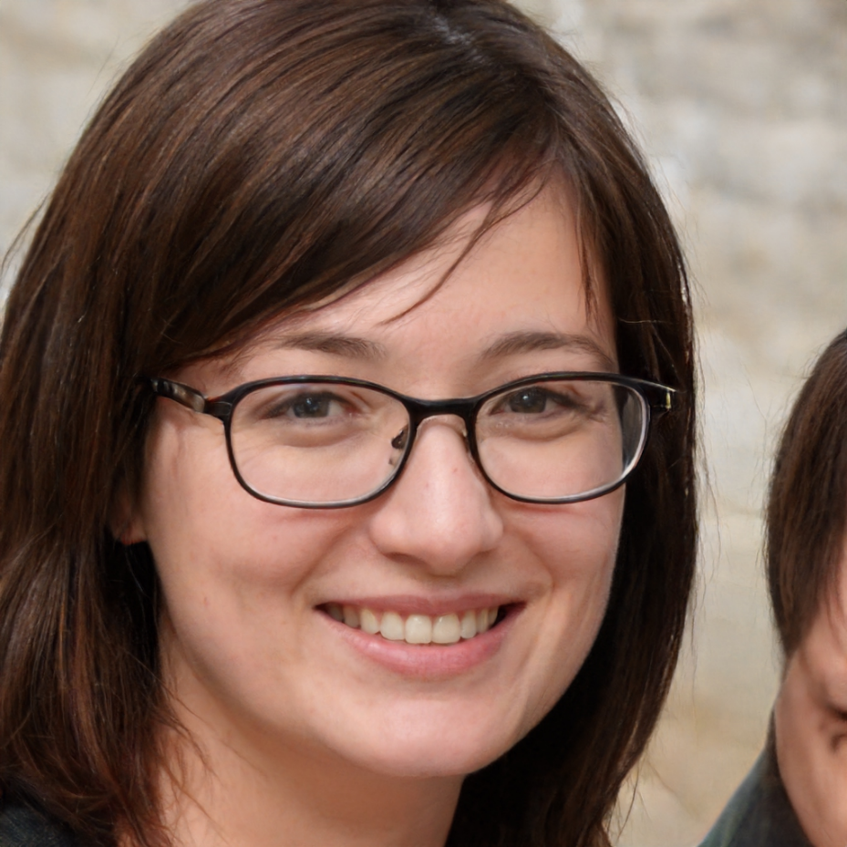
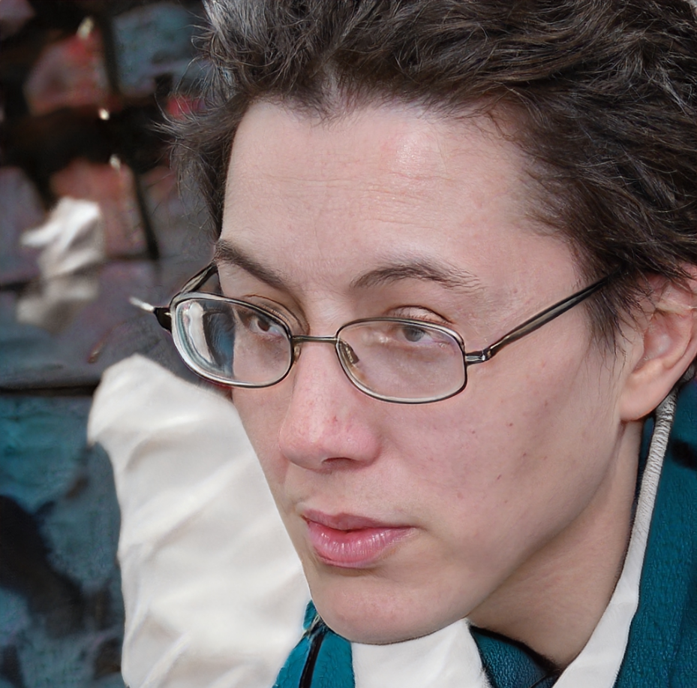


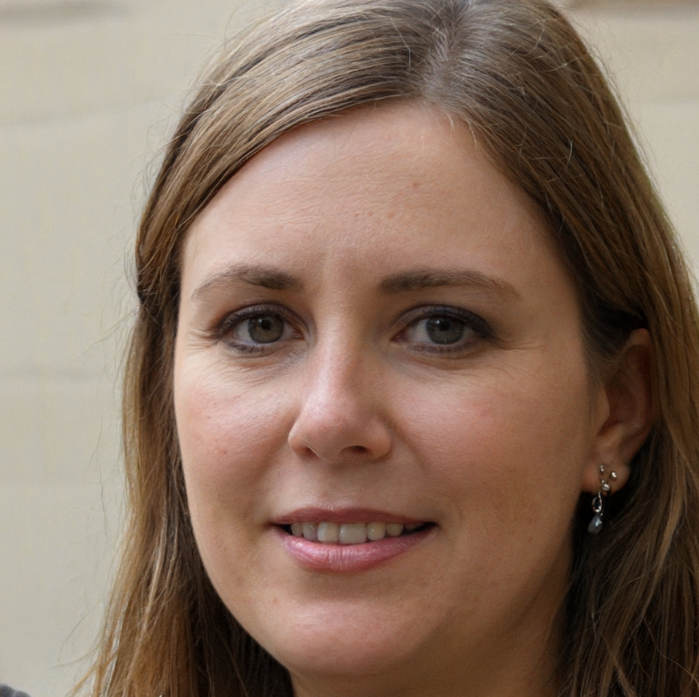


How many of these people aren’t real?

Slide 66
How many of these people aren’t real?
Source of pictures: https://thispersondoesnotexist.com/

Slide 67
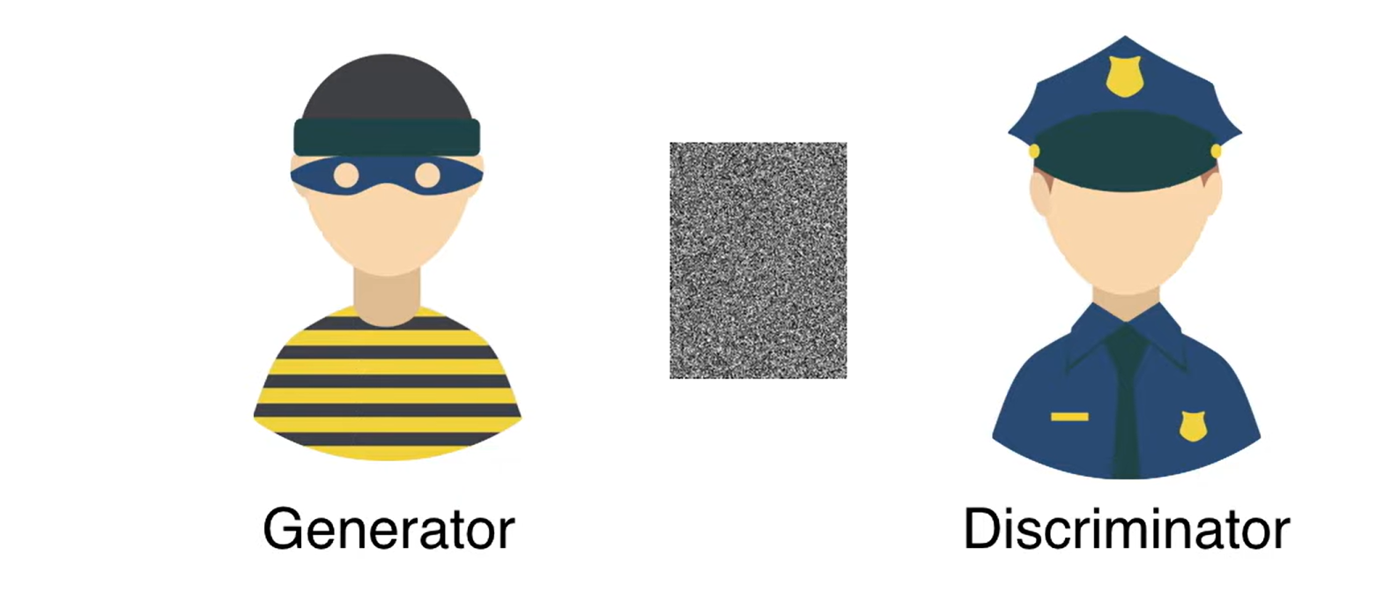
How does a GAN work?
Real
https://www.youtube.com/watch?v=8L11aMN5KY8

Slide 68
How does a GAN work?
Fake
https://www.youtube.com/watch?v=8L11aMN5KY8

Slide 69
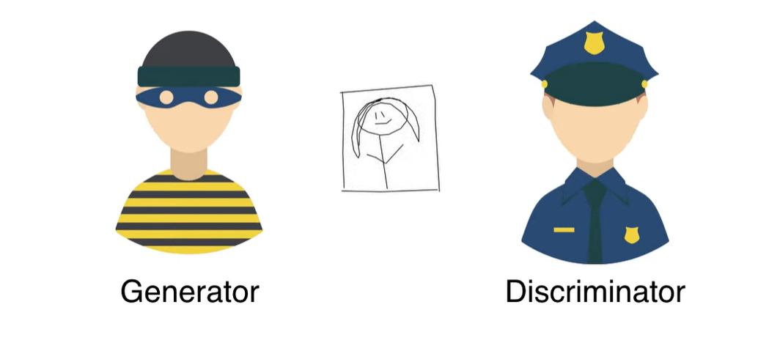
How does a GAN work?
Real

Slide 70

How does a GAN work?
Real

Slide 71

How does a GAN work?
Real

Slide 72
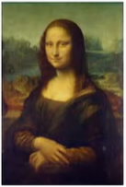
How does a GAN work?
Real

Slide 73

GAN Architecture
Real Image Samples
Discriminator
Real/Fake
Random Seed
Generator
Fake

Slide 74
GAN Training
Backpropagation
Discriminator
Loss
Real Image Samples
Discriminator
Random Seed
Generator
Generator
Loss
Fake
Backpropagation

Slide 75
GAN Definition
Generative
A network, which creates its own training data
Adversarial
2 enemies are competing against each other in the form of a zero-sum game,
one agent’s gain is the others loss
Network
Both adversaries are usually neural networks

Slide 76
Common Problems
Vanishing gradient
the discriminator is a lot better than the generator
the generator could be stuck with a very high loss regardless of how the weights are changed
gradient is close to 0 → “vanishing”
Mode Collapse
the generator produces an especially plausible output → it will only produce this output
In response the discriminator might start to always reject this output and is stuck in a local optimum
Now it‘s too easy for the next iteration of generators to find an especially plausible output
→ generator over-optimizes for a particular discriminator, and the discriminator never manages to learn its way out of the trap
Failure to converge
if the generator is perfect and its results are indistinguishable to the real examples the discriminator will have to guess
if we don‘t stop the training of the generator in time, the training will be based on guesses instead of real features

Slide 77
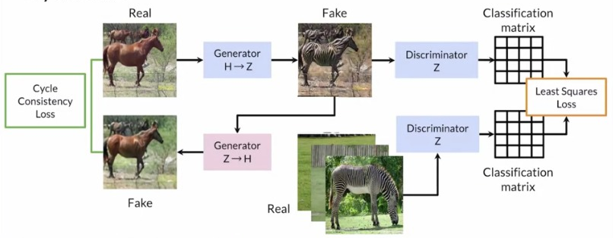
GAN Usecases: Cycle GAN
https://1.bp.blogspot.com/-F7lW08tA2t0/X5424ebzBqI/AAAAAAAAKiA/zq24RKnPc5wwDvjqS7EUuXDzMPb_2rJaACLcBGAsYHQ/s806/Google%2BChromeScreenSnapz098.jpg

Slide 78

GAN Usecases: Cycle GAN
https://junyanz.github.io/CycleGAN/

Slide 79
GAN Usecases: Super Resolution GAN (SRGAN)
Discriminator
Loss
High-resolution image
Discriminator
Downsampling
Low-resolution image
Generator
Generator
Loss
Super-resolution image

Slide 80

GAN Variations: Super Resolution GAN (SRGAN)
https://www.youtube.com/watch?v=WCAF3PNEc_c

Slide 81

GAN Usecases: Super Resolution GAN (SRGAN)
https://www.youtube.com/watch?v=WCAF3PNEc_c

Slide 82


GAN Usecases: Adversarial examples
https://developer.nvidia.com/blog/wp-content/uploads/2019/06/fig1.jpg
https://encrypted-tbn0.gstatic.com/images?q=tbn:ANd9GcSAogVMMcFjWsUK-OYPgLafvDi9F9fWhKOMcw&usqp=CAU

Slide 83

GAN Usecases: Adversarial examples
https://2.bp.blogspot.com/-u0kQgNLcDE0/W5mkeCR5EUI/AAAAAAAADU8/-X2_V_Xg9vwXRaZnutPfQgCrJ18csyXYQCLcBGAs/s1600/image1.png

Slide 84

GAN Usecases: Adversarial examples
https://www.mdpi.com/applsci/applsci-11-01865/article_deploy/html/images/applsci-11-01865-g001.png

Slide 85
Deep Reinforcement Learning (Deep RL)
xx

Slide 86

Deep Reinforcement Learning Overview
What: Combination of framework of reinforcement learning and neural network, helps agents to solve sequential decision-making problems
How: Trial and error in a world that provides occasional rewards
→ an agent (an AI) will learn from the environment by interacting with it (through trial and error) and receiving rewards (negative or positive) as feedback for performing actions.
Source: DeepRM-HotNets

Slide 87





Deep Reinforcement Learning Overview
Picture 1
Picture 2
Picture 3
Picture 4

Slide 88
Reinforcement Learning Framework
Agent: An agent perceives its environment and takes actions
Action (A): A is the set of all possible moves the agent can make.
Environment: The world through which the agent moves, and which responds to the agent.
State (S): A state is a concrete and immediate situation in which the agent finds itself
Reward (R): A reward is the feedback by which we measure the success or failure of an agent’s actions in a given state.
Policy (π): The policy is the strategy that the agent employs to determine the next action based on the current state. It maps states to actions, the actions that promise the highest reward.
Value (V): The expected long-term return with discount, as opposed to the short-term reward R. Vπ(s) is defined as the expected long-term return of the current state under policy π.

Slide 89
Reinforcement Learning Framework
At each step, the agent:
Observe new state
Executes action
Receive reward
State
Terminal State
Action
Reward

Slide 90
Reinforcement Learning Framework
Future Reward: R_{t} = r_{t} + r_{t+1} +r_{t+2} + …+ r_{n}
Discounted future reward: R_{t} = r_{t} + γr_{t+1} + γ²r_{t+2} + …+ γ^{n-t}r_{n}
The discount factor γ is multiplied by future rewards as discovered by the agent in order to dampen these rewards’ effect on the agent’s choice of action. It is designed to make future rewards worth less than immediate rewards.
If γ is .8, and there’s a reward of 10 points after 3-time steps, the present value of that reward is 0.8³ x 10. A discount factor of 1 would make future rewards worth just as much as immediate rewards.
Why discounted?
The fact that the discount rate is bounded to be smaller than 1 is a mathematical trick to make an infinite sum finite. This helps proving the convergence of certain algorithms.
In practice, the discount factor could be used to model the fact that the decision maker is uncertain about if in the next decision instant, the world (e.g., environment / game / process ) is going to end.
A good strategy for an agent: always choose an action that maximizes the discounted future reward

Slide 91
Reinforcement Learning Framework
Model-based RL uses experience to construct an internal model of the transitions and immediate outcomes in the environment. Appropriate actions are then chosen by searching or planning in this world model. In such a system, preferences take priority over the consequences of the actions i.e. the greedy agent will always try to perform an action that will get the maximum reward irrespective of what that action may cause.
Model-free RL uses experience to learn directly one or both of two simpler quantities (state/ action values or policies) which can achieve the same optimal behavior but without estimation or use of a world model. Model-free algorithms seek to learn the consequences of their actions through experience via algorithms such as Policy Gradient, Q-Learning, etc.
→If the agent can predict the reward for some action before actually performing it thereby planning what it should do, the algorithm is model-based. While if it needs to carry out the action to see what happens and learn from it, it is model-free.

Slide 92

Reinforcement Learning Framework

Slide 93

Q-Learning
Q-Learning is most primitive, but big part of algorithms to learn reinforcement learning
The Q in Q-learning stands for quality. Quality in this case represents how useful a given action is in gaining some future reward.
Value based approach based on the so-called Q-Table
Q-Table calculates the maximum expected future reward for each action at each state
One cheese = +1 point
Two cheese = +2 points
Big pile of cheese = +10 points (end of the episode)
Rat poison =-10 points (end of the episode)

Slide 94

Q-learning Algorithm
1. Initialize Q-Table
2. Choose action a for state s
3. Perform action a, new state s‘
4. Measure reward R
5. Update Q-Table with Bellman Equation
A number of iterations – result a good Q-table

Slide 95
Q-learning Algorithm
Start
Initialize Q-Table
Choose action a for state s
Action
 | ← | → | ↑ | ↓
Start | 0 | 0 | 0 | 0
1 * Cheese | 0 | 0 | 0 | 0
Nothing | 0 | 0 | 0 | 0
2 * Cheese | 0 | 0 | 0 | 0
Rat Poison | 0 | 0 | 0 | 0
Big Pile of Cheese | 0 | 0 | 0 | 0
State
Perform action a, new state s‘
Measure reward R
Update Q-Table with Bellman Equation

Slide 96

Exploration vs Exploitation
In the beginning choose the action randomly so that the agent can explore the environment
The more training steps we get, the more we reduce the random exploration and use exploitation instead
Eplison ε Parameter

Slide 97

Q-learning Algorithm
Start
Initialize Q-Table
Choose action a for state s
Action
 | ← | → | ↑ | ↓
Start | 0 | 0 | 0 | 0
1 * Cheese | 0 | 0 | 0 | 0
Nothing | 0 | 0 | 0 | 0
2 * Cheese | 0 | 0 | 0 | 0
Poison | 0 | 0 | 0 | 0
Big Pile of Cheese | 0 | 0 | 0 | 0
Perform action a, new state s‘
State
Measure reward R
Update Q-Table with Bellman Equation

Slide 98

Q-learning Algorithm
Bellman Equation:
Learning rate: a number between 0 -1, indicates how quickly agent abondons previous Q value in Q-table for new Q value for a given state action pair.
$$Qnew\left(s,a\right)=Q\left(s,a\right)+ α ·[R\left(s,a\right)+γ·maxQ^{′}\left(s^{′},a^{′}\right)−Q\left(s,a\right)]$$
$$Qnew\left(s,a\right)=0+0.1·[ 1+0.9·\max\left(Q^{′}\left(1cheese,left\right),Q^{′}\left(1cheese, right\right),Q^{′}\left(1cheese,down\right)\right)− 0 ]$$
$$Qnew\left(s,a\right)=0+0.1·\left[ 1+0.9·0− 0 \right]=0.1$$

Slide 99
Q-learning Algorithm
Initialize Q-Table
Choose action a for state s
Action
 | ← | → | ↑ | ↓
Start | 0 | 0.1 | 0 | 0
1 * Cheese | 0 | 0 | 0 | 0
Nothing | 0 | 0 | 0 | 0
2 * Cheese | 0 | 0 | 0 | 0
Poison | 0 | 0 | 0 | 0
Big Pile of Cheese | 0 | 0 | 0 | 0
Perform action a, new state s‘
State
Measure reward R
Update Q-Table with Bellman Equation
A number of iterations – result a good Q-table

Slide 100

Deep Q-learning (DQN)
Initialize Q-Table
Choose action a for state s
Perform action a, new state s‘
Measure reward R
Update Q-Table with Bellman Equation
A number of iterations – result a good Q-table

Slide 101

Supervised vs Unsupervised vs Reinforcement Learning
Unsupervised learning:
That thing is like this other thing.
Supervised learning:
That thing is a “cheeseburger”.
Reinforcement learning:
Eat that thing because it tastes good and will keep you alive longer.

Slide 102

Real-Life Examples of Deep Reinforcement Learning
Autonomous driving (e.g., AWS DeepRacer)
Industry automation (e.g., Deepmind to cool Google Data Centers)
Games (e.g., AlphaGo)
Chatbots (e.g., MILABOT)
Targeted Marketing
Health
NLP (Natural Language Processing)
Engineering
...

Slide 103
Resources
Reinforcement Learning algorithms (Python Tutorial)
A Beginner's Guide to Deep Reinforcement Learning
Deep Reinforcement Learning: Guide to Deep Q-Learning
Introduction to Deep Reinforcement Learning
An Introduction to Deep Reinforcement Learning
10 Real-Life Applications of Reinforcement Learning
Notes:
- Nice to work together in a bigger team of data science enthusiasts

Slide 104
Model Explainability
Sahana Krishna Murthy

Slide 105



Model Explainability Overview
Definition: ML Model Explainability (sometimes referred to as Model Interpretability) is a fundamental pillar of AI Quality.
Interpretability → understanding decision rules and cutoffs and the ability to manually derive the outputs of the model
Explainability → identifying which parts of an input were most important for the resulting prediction or which changes to an input would result in a different prediction
Consider a scenario: You must classify images into pandas and polar bears. You'd expect the model to learn panda specific features like black furs. Your trained model gives the best accuracy and the best F1 score there is.
Training images: Misclassified image:
Most of the panda pictures happen to have a forest background. The model saw snow and classified the image as polar bear. In short, you just built an amazing snow detector. Not an animal classifier.

Slide 106
Need of Model Explainability
Need:
Trust - to be able to interpret a model increases trust in a machine learning model.
Model debugging – at development phase in analyzing whether a model has learned expected concepts
Auditing - in the context of fairness, safety, or security it can be very helpful to understand the internals of a model, and even partial explanations may provide insights.
Regulation – legal requirements to provide explanations about (automated) decisions to users of a system in some contexts. Explainability mechanisms may be helpful to meet the regulatory standards.
E.g., The European Union’s 2016 General Data Protection Regulation (GDPR) includes a rule framed as Right to Explanation for automated decisions.

Slide 107

Model Understanding
Option 1: Build models that are inherently interpretable.
Example: Linear models, Decision trees
Option 2: Post-hoc explanation of Black Box Models
Examples – Tree based Ensemble models, Deep Learning

Slide 108


Choice of Model Explainability techniques

Slide 109
Explainable AI (XAI) methods
SHAP and LIME are both popular Python libraries for model explainability.
LIME
Local Interpretable Model-agnostic Explanations
SHAP
Shapley Additive Explanations
A method developed by Marco Ribeiro (2016) explains the classifier for a specific single instance and is therefore suitable for local explanations.
LIME manipulates the input data and creates a series of artificial data containing only a part of the original attributes.
A method developed by Lundberg and Lee (2016) to explain individual predictions, based on the game theoretically optimal Shapley values.
Shapley value is the average of the marginal contributions across all permutations.

Slide 110


SHAP
Install:
Tree ensemble example:

Slide 111


SHAP
Global prediction with Waterfall plot:
Local prediction with Force plot:

Slide 112



Microsoft open-source tools
FairLearn
InterpretML
SmartNoise
Run analysis to identify and address potentially biased selections/outcomes.
Run analysis to understand, debug, explain, and audit ML models.
Insert synthetic data into data sets to reduce risk of deanonymization/breach.
Notes:
Microsoft continues to release Responsible AI tools, most of them as open-source, several of which can connect into a single dashboard. In addition to fairness testing, interpretability, and differential privacy, there are also tools for security and error analysis as well as a toolkit for improving human/machine interactions it calls HAX (human-AI experience).

Slide 113

Responsible AI
Delivering leading-edge data and AI solutions with confidence, inspired by sound digital ethics.
Given the tremendous scale we can achieve with artificial intelligence solutions, any ethical impact on individuals, society, and/or the environment – positive or negative - may be greatly multiplied. It’s our responsibility to continuously strive for positive ethical outcomes.
At Avanade:
Responsible AI Assessment
Avanade’s comprehensive Digital Ethics Assessment can uncover the ethical implications of any project or system, highlighting a path to improvement.
Avanade cares about making a genuine human impact, and as a responsible business, we should be working to make that impact as ethically positive as possible (i.e. by reducing harmful biases, privacy breaches, abuse, misuse, and other harms; and by improving inclusivity, accessibility, respect for human dignity, etc.). Practically, building explainability into a model helps us better understand all the ways it might impact individuals, which allows us to identify potential risks and gaps in the system.
RESPONSIBLE AI ASSETS
The combination of Microsoft’s technical solutions and Avanade’s domain expertise makes Responsible AI a viable goal.
Avanade Assets
Responsible AI Checklist Powerapp
Digital Ethics Assessment Framework
Responsible AI Control Framework
Microsoft Assets
Fairness testing (MS Fairlearn)
Differential Privacy (WhiteNoise)
AI Explainability (InterpretML)
Notes:
Finally, I’ll leave you with a simply one-pager. I’d love to support any conversations with clients and prospects on these topics, but you’re also welcome to use this slide to explain our Responsible AI point of view and capabilities.

